Slide 1
UCSD Embedded C Final Assignment
By
Hsuankai Chang
hsuankac@umich.edu

Slide 2
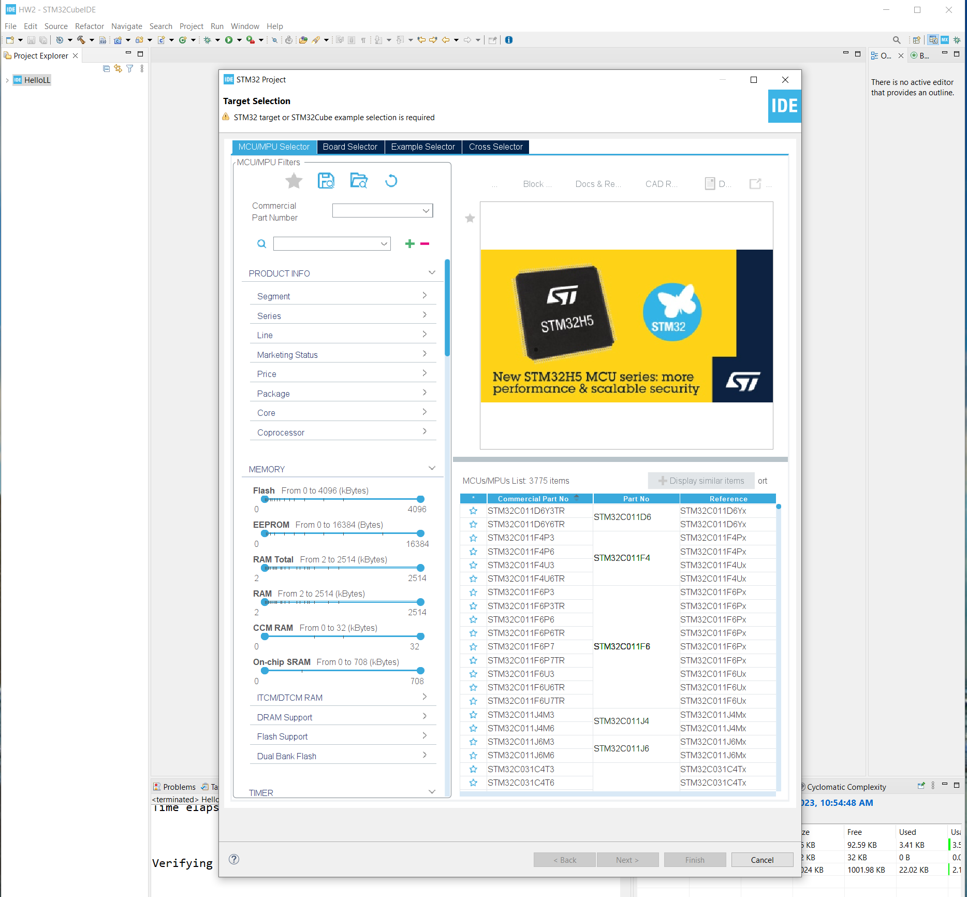
Step 1. Startup STM32CubeIDE and create new STM32 project

Slide 3
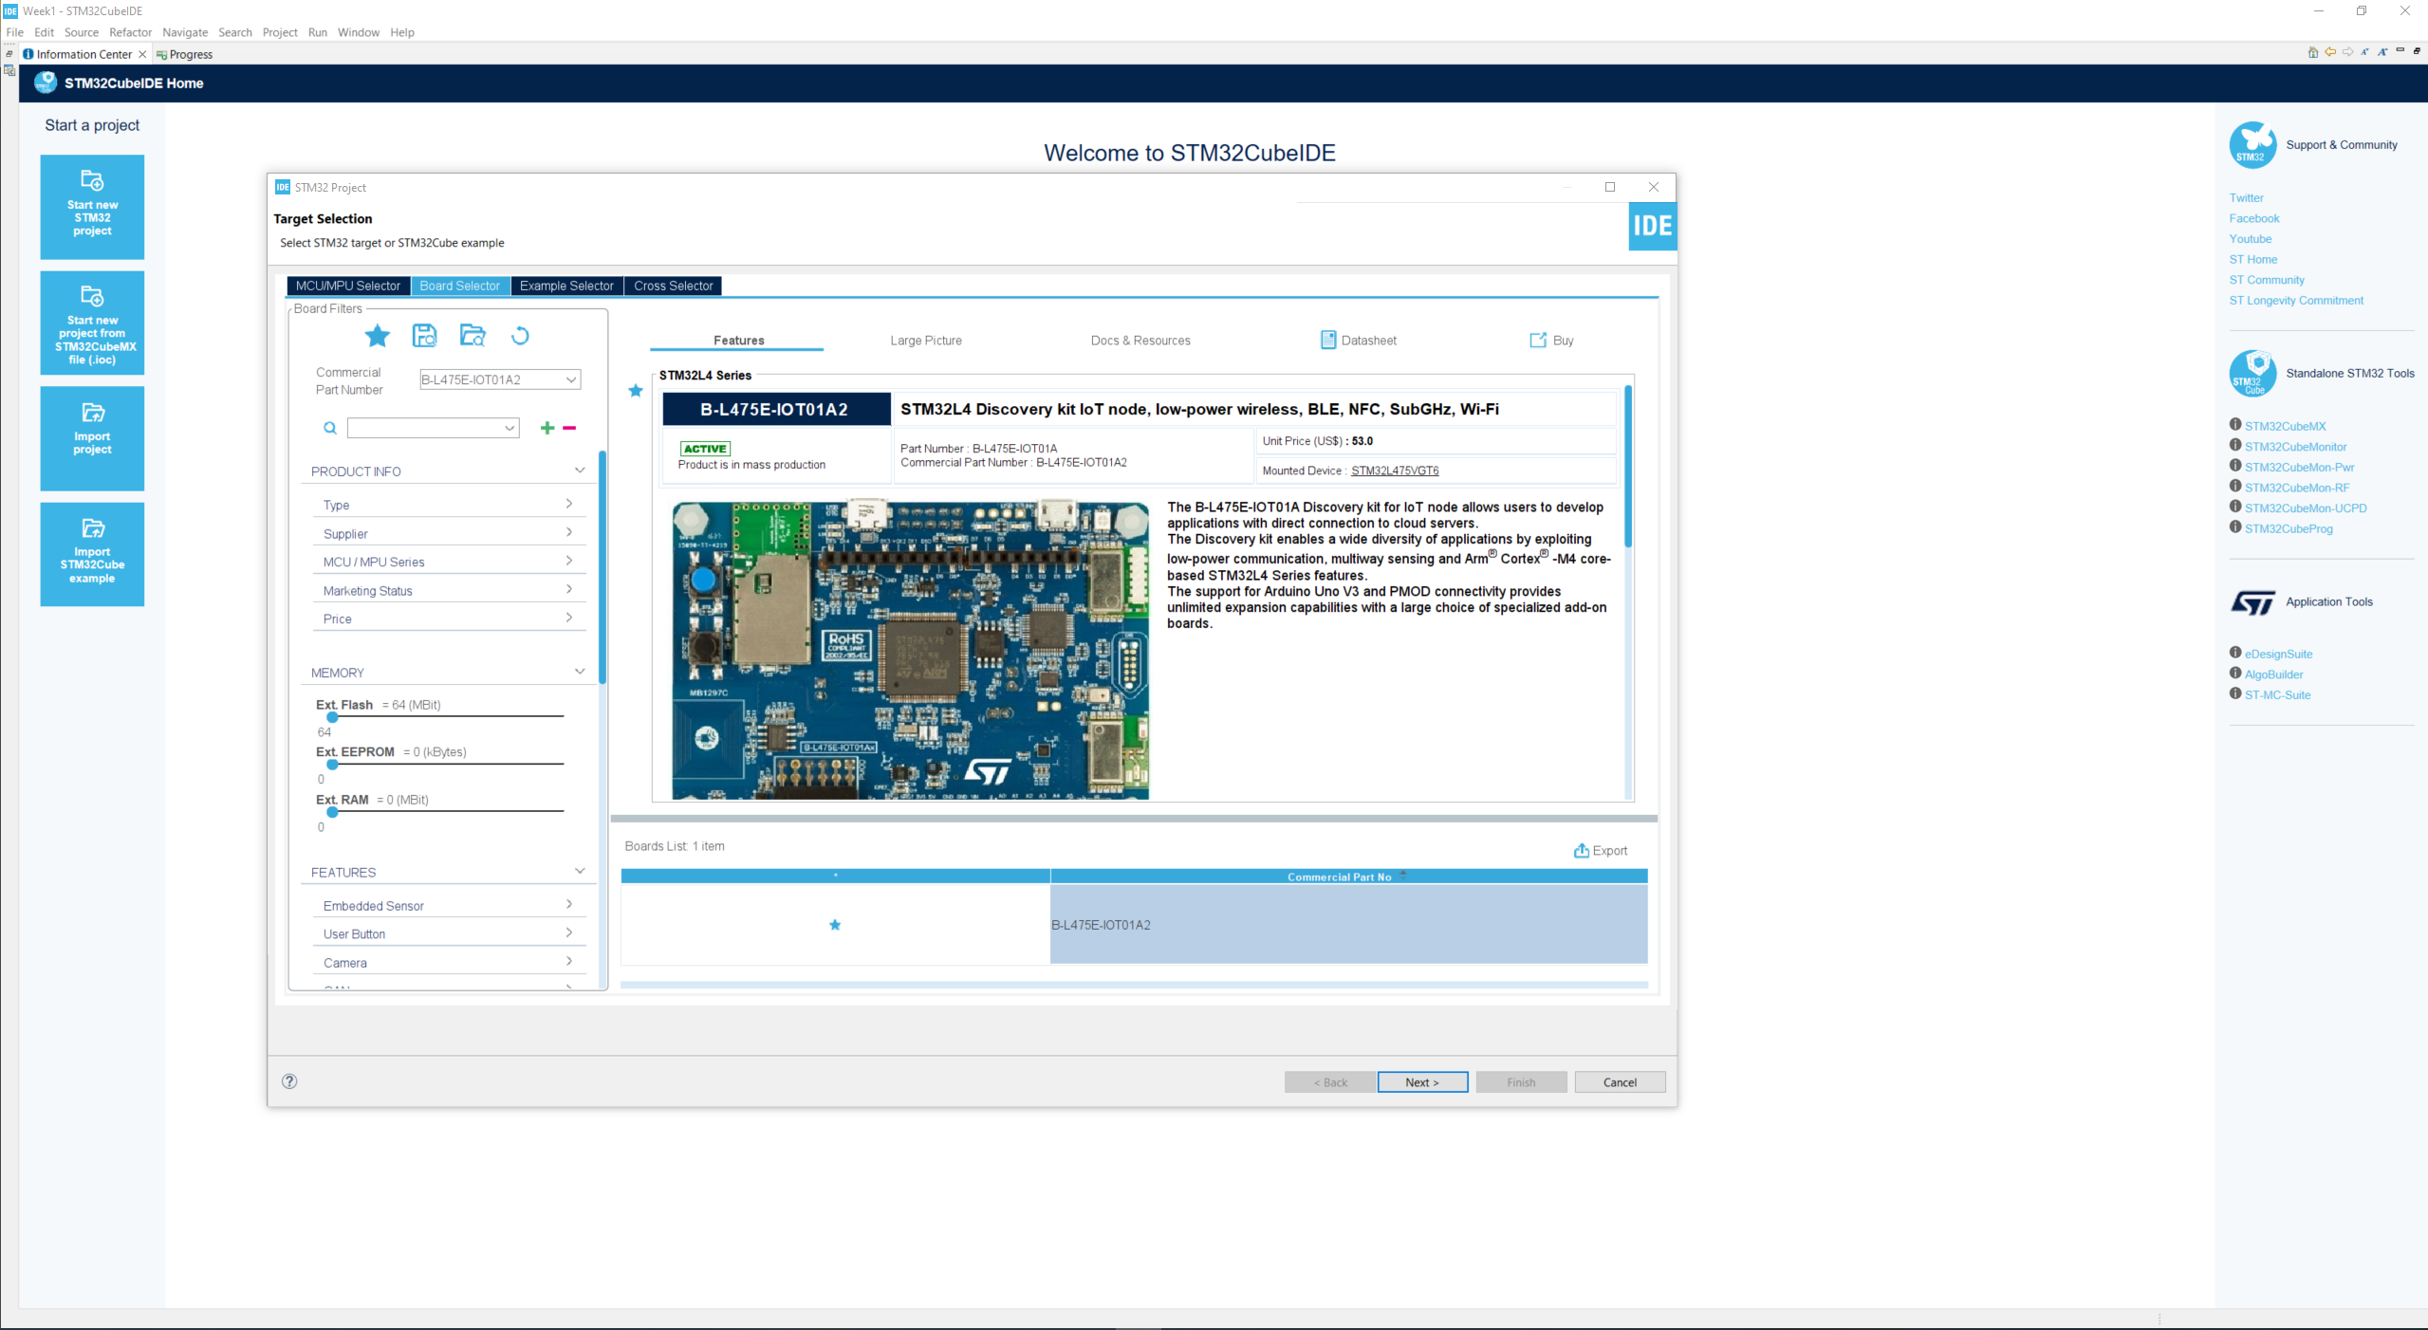
Step 2. Access board selector and type in the board you use, enter project name and click Next

Slide 4
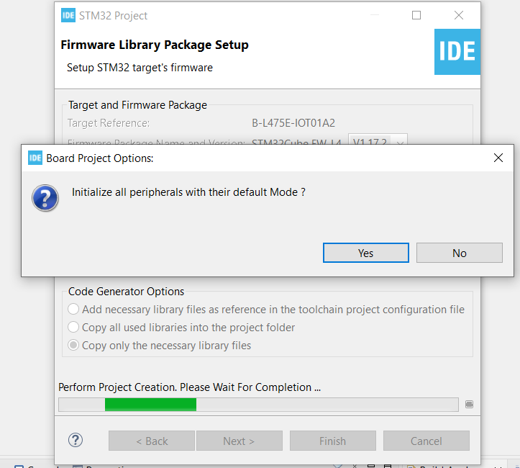
Step 3. Click yes to initialize all peripherals to default

Slide 5
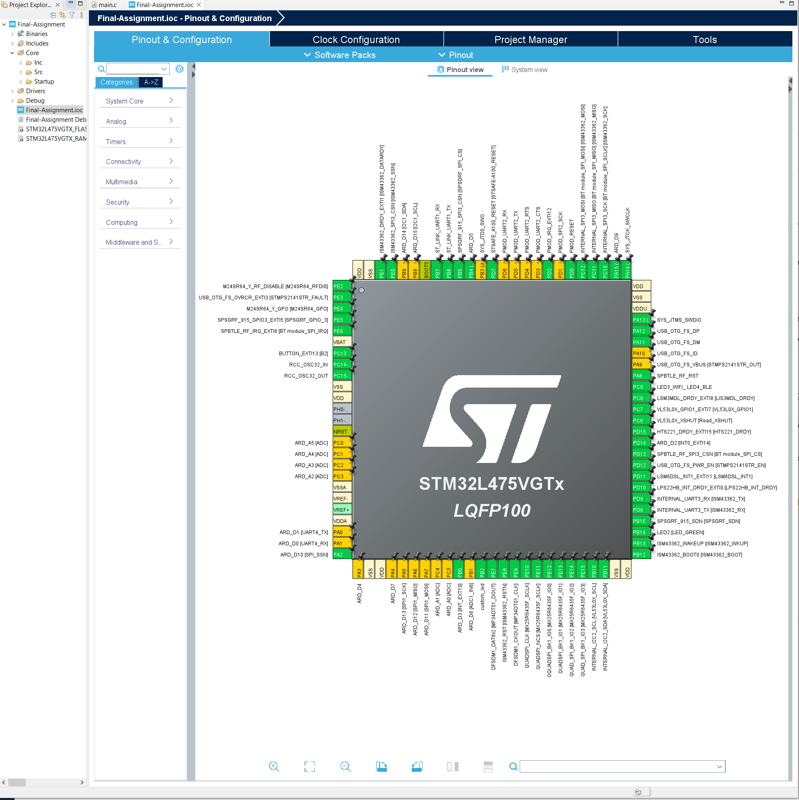
Step 4. When in .ioc file, view the overall default settings

Slide 6
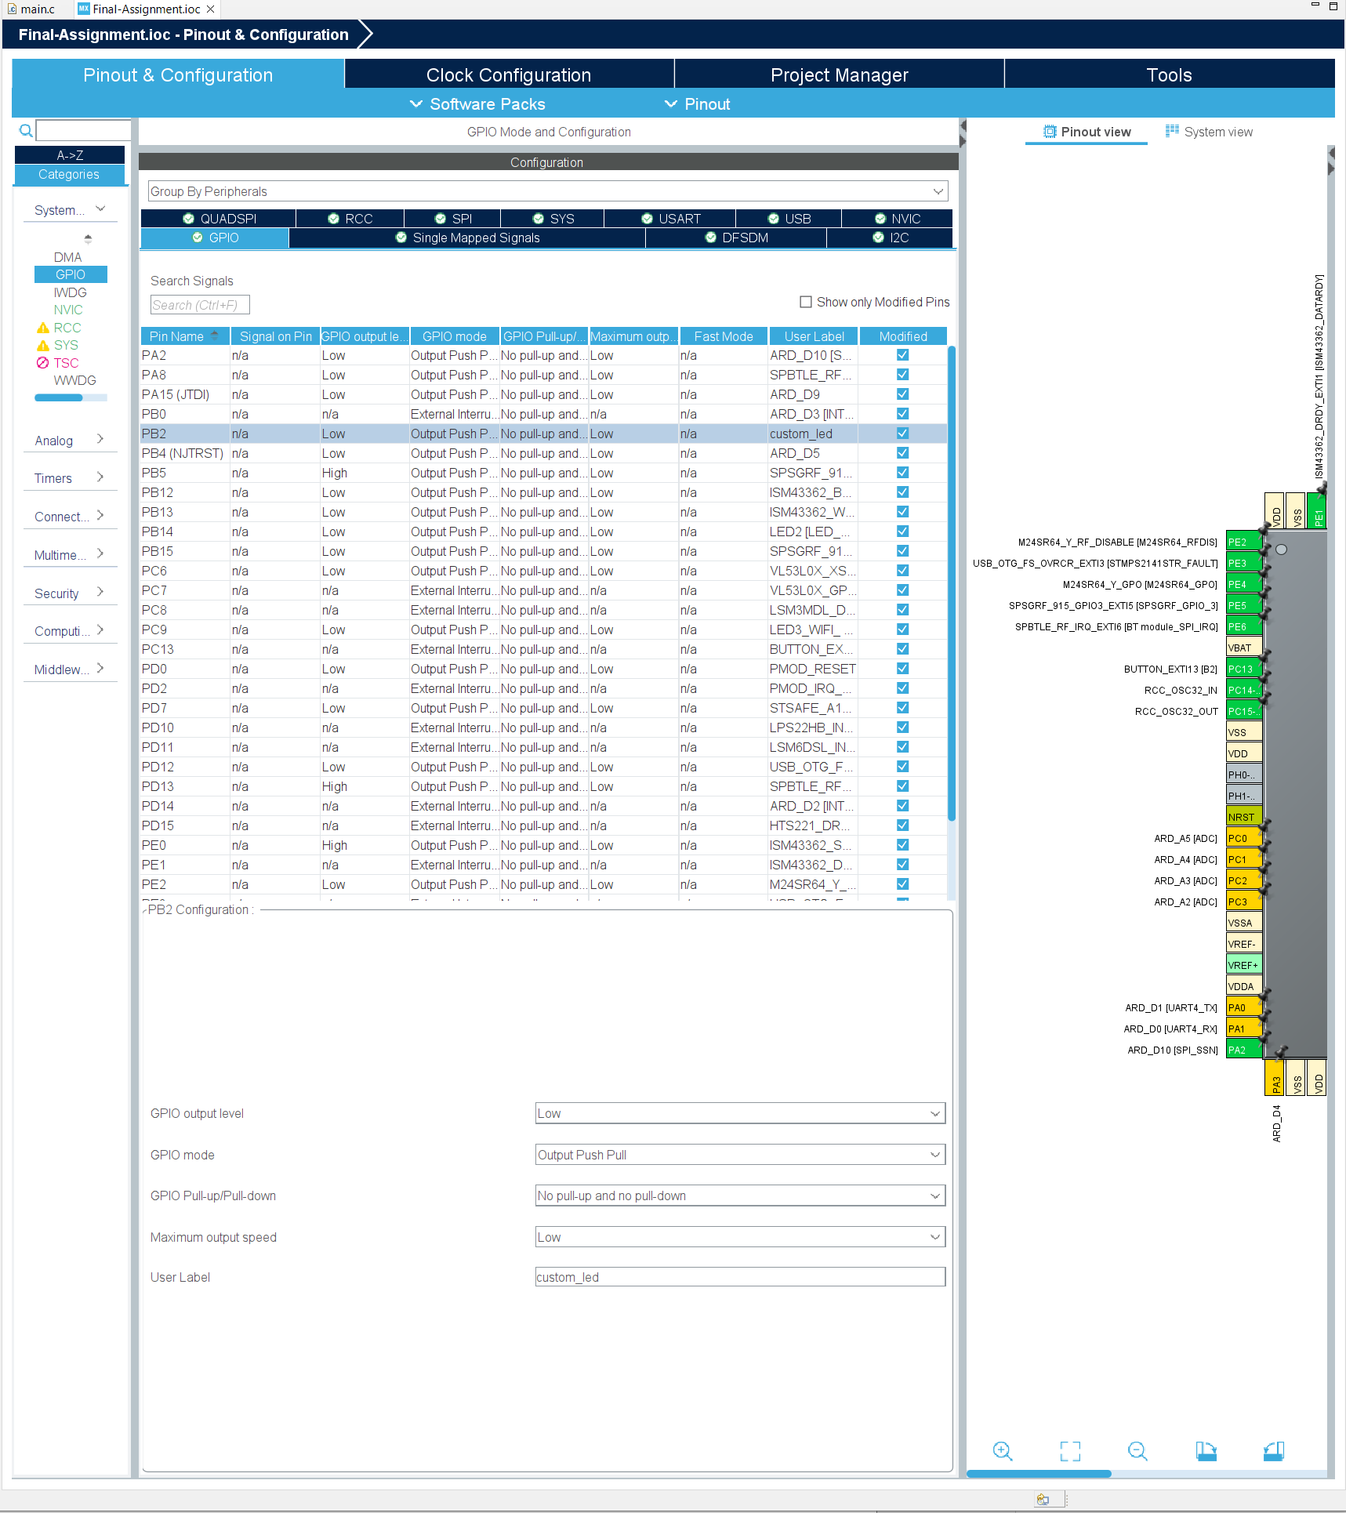
Step 5. Click GPIO and set PB2 pin as custom_led output push pull pin, we will use this pin to toggle external LED for demo 4

Slide 7
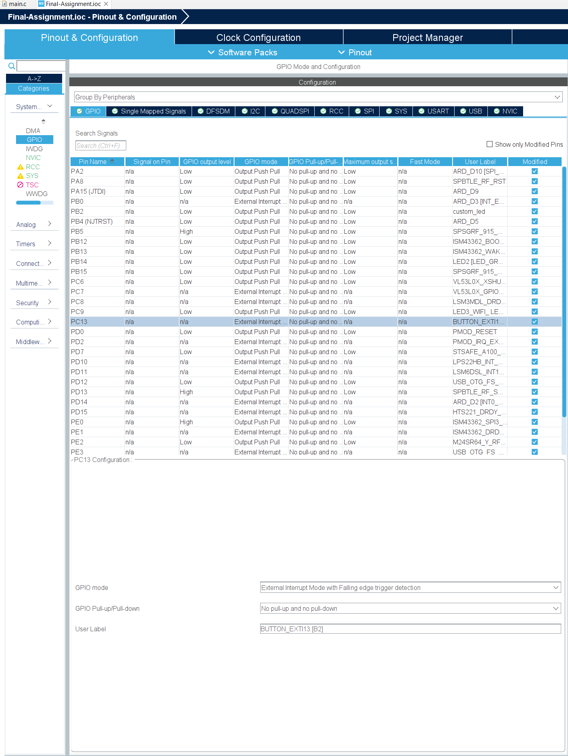
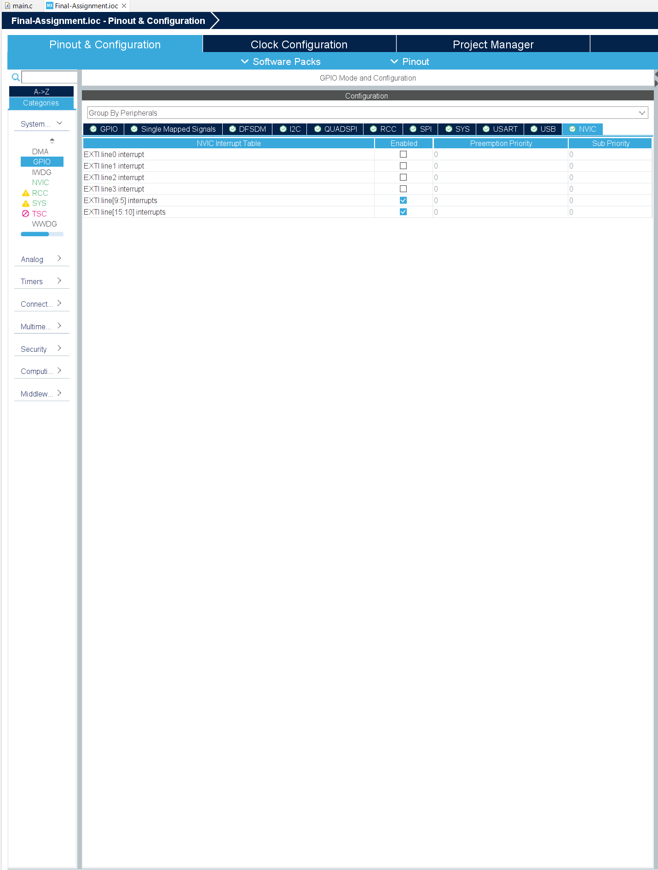
Step 6. Confirm that blue button has set up as external interrupt trigger

Slide 8
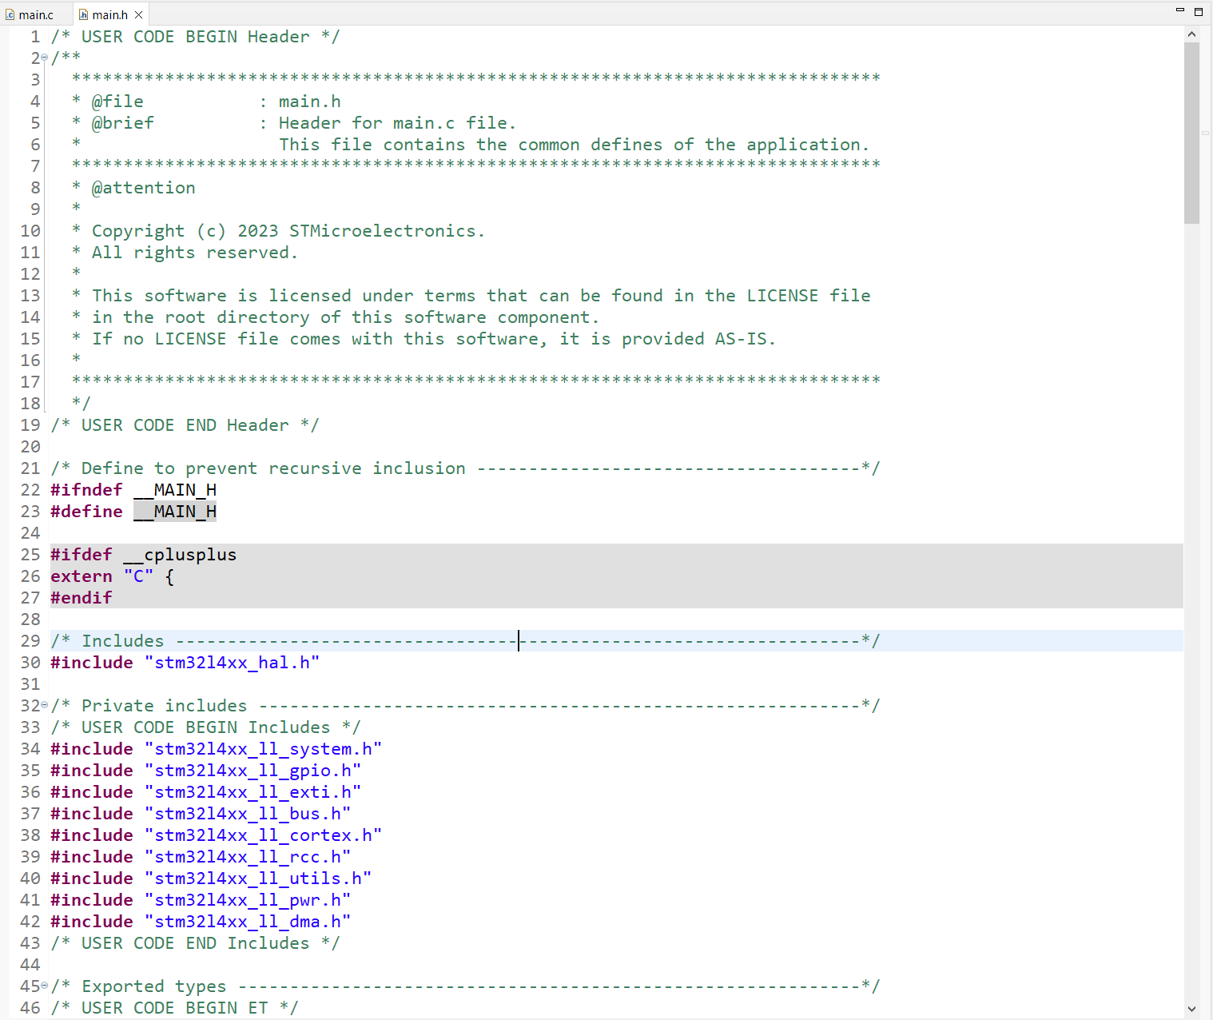
Step 7. Generate the code, and in main.h file, and the required low layer header file for use in demo 1

Slide 9
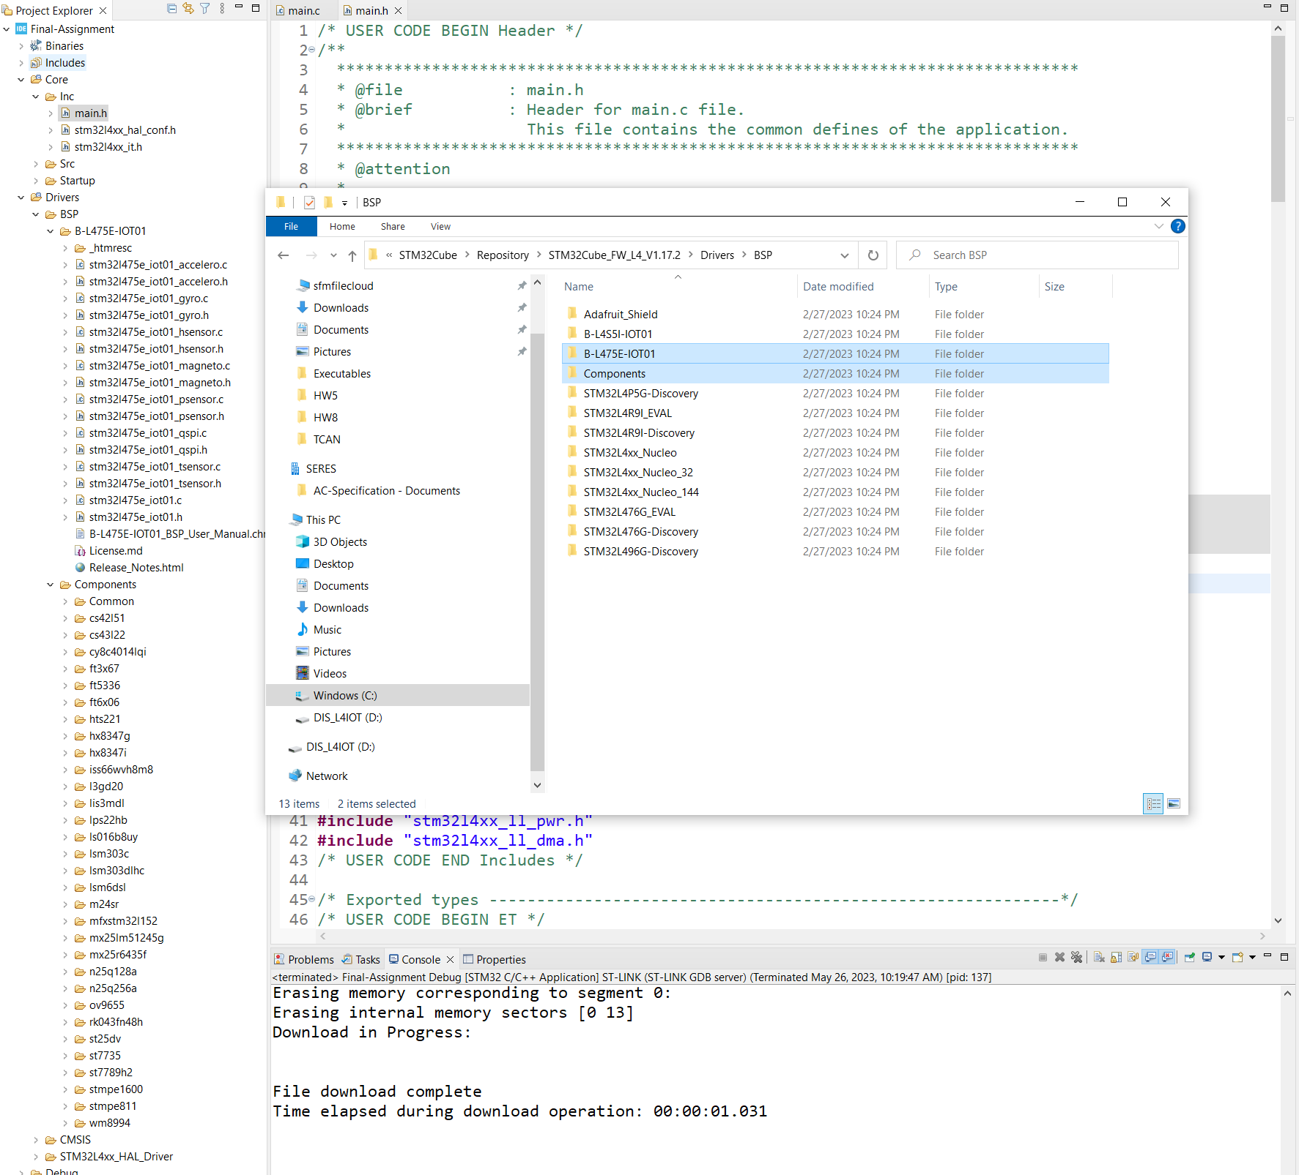
Step 8. Create BSP folder under Drivers folder, and copy and paste the local Components and B-L475E-IOT01 folder to it. This is for using BSP package for temp sensor in demo 3

Slide 10
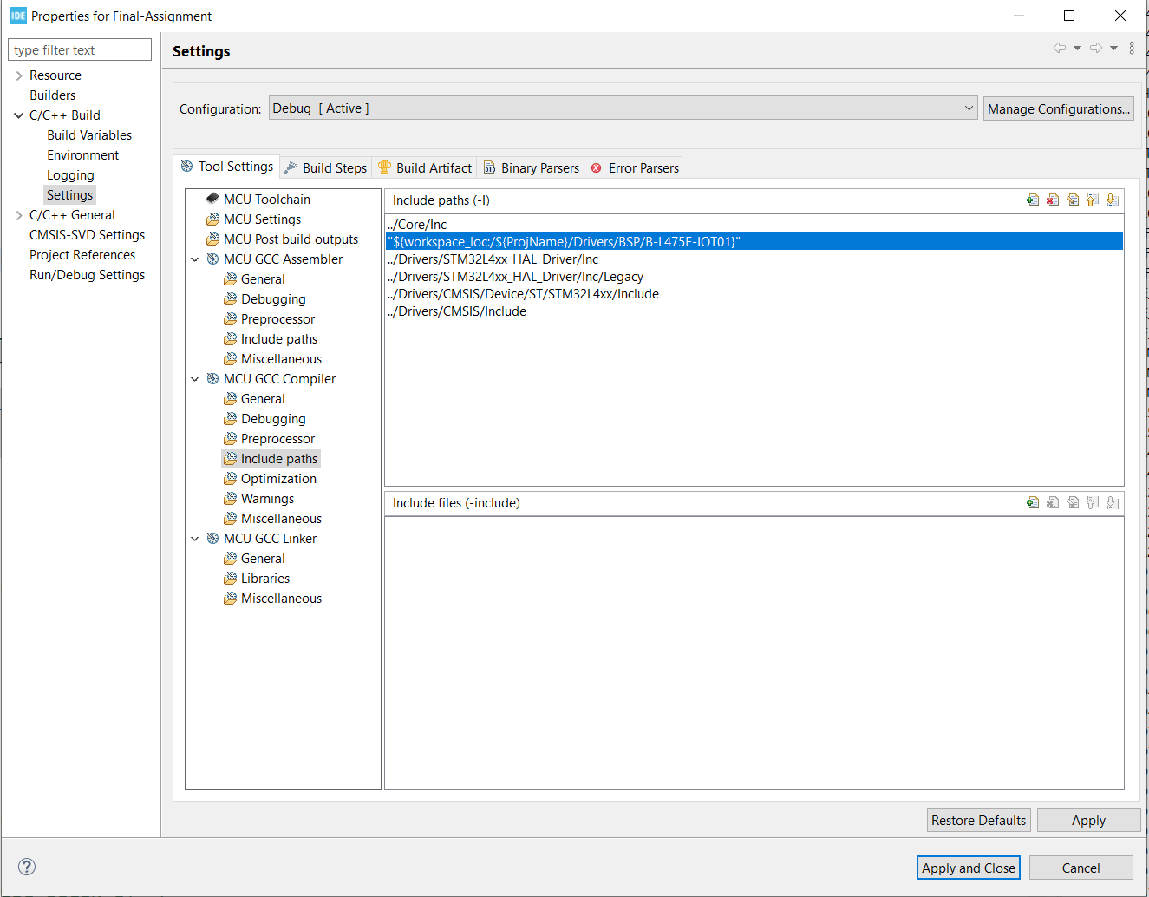
Step 9. Add the BSP folder to the include path

Slide 11
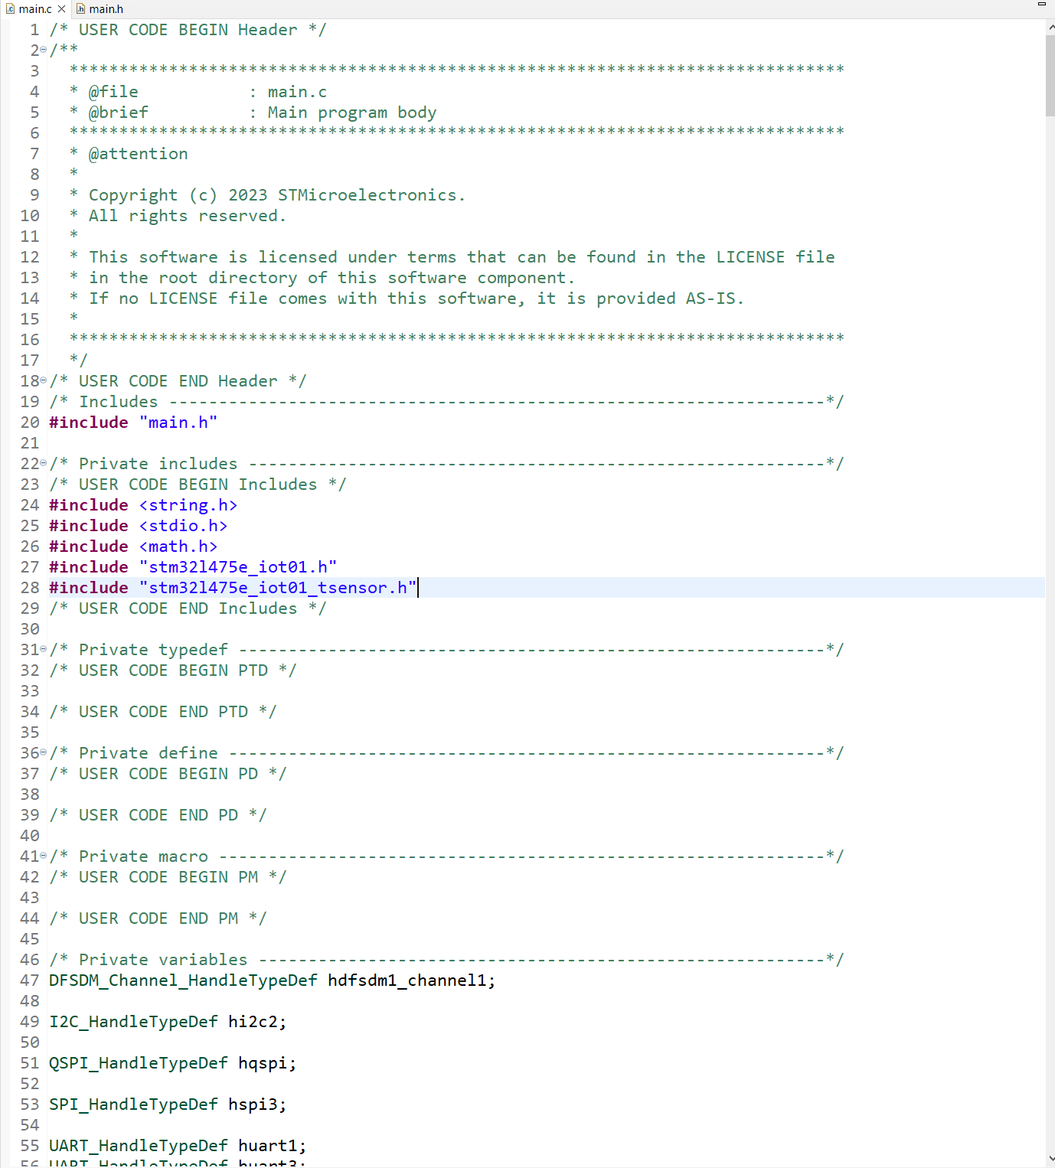
Step 10. In main.c file, add the required header files

Slide 12
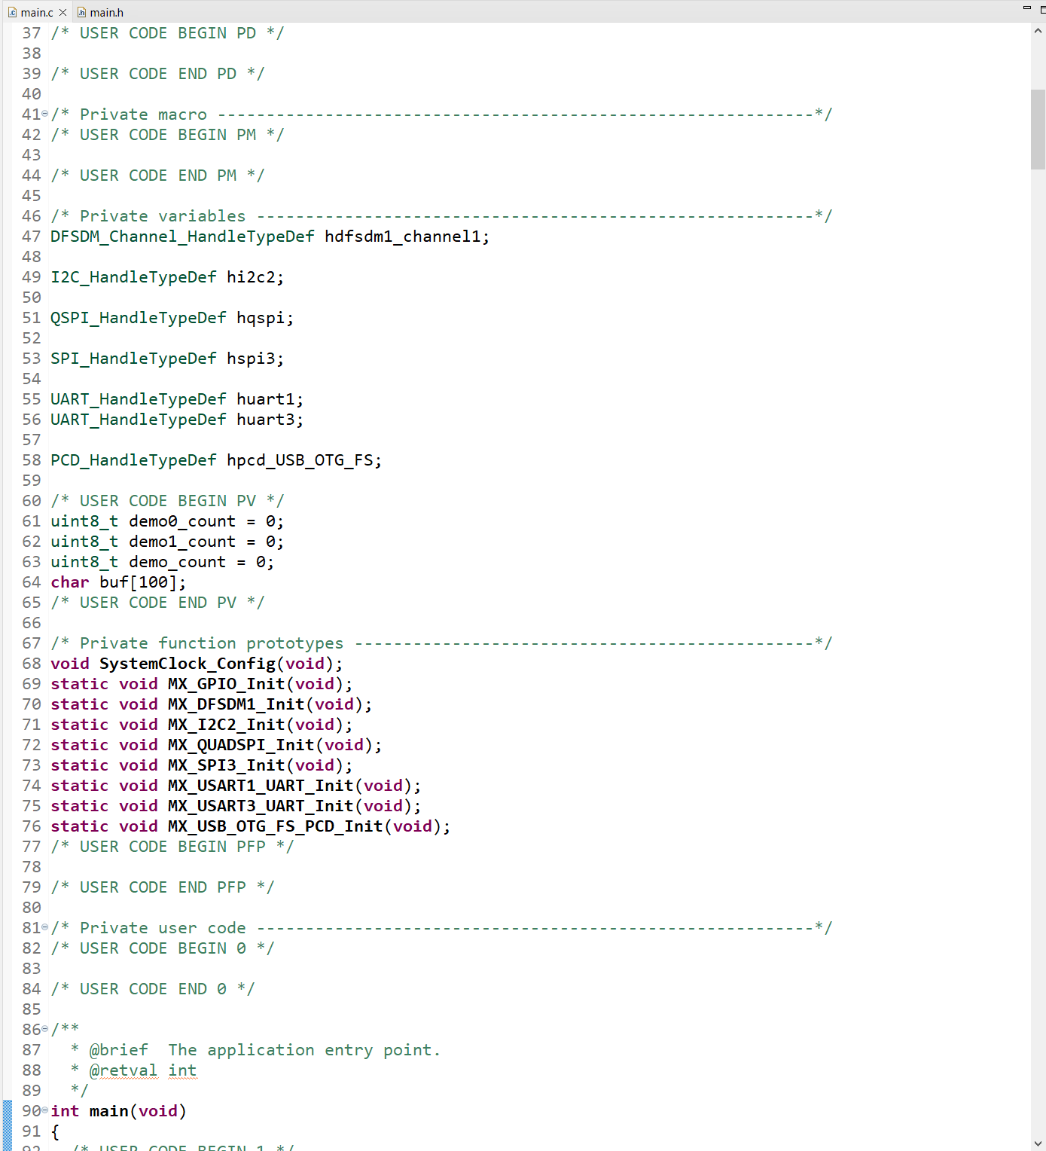
Step 11. In main.c, add the needed variables

Slide 13
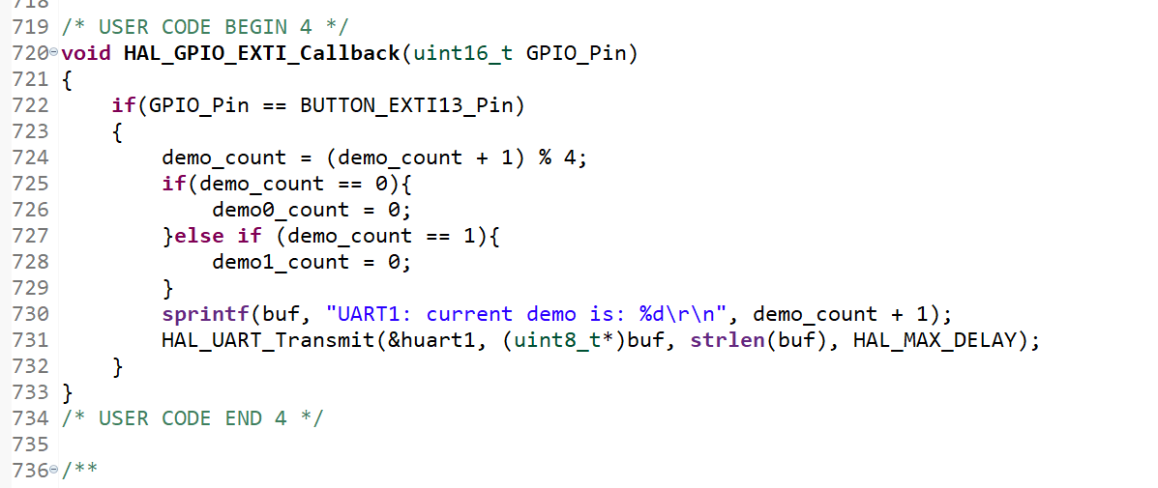
Step 12. Add the function definition for EXTI call back function

Slide 14
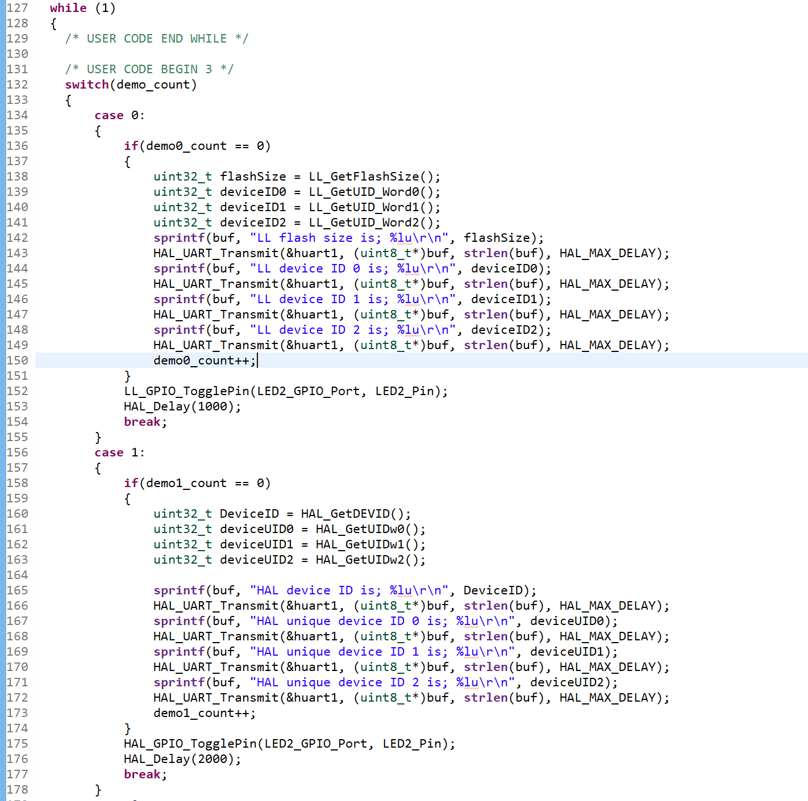
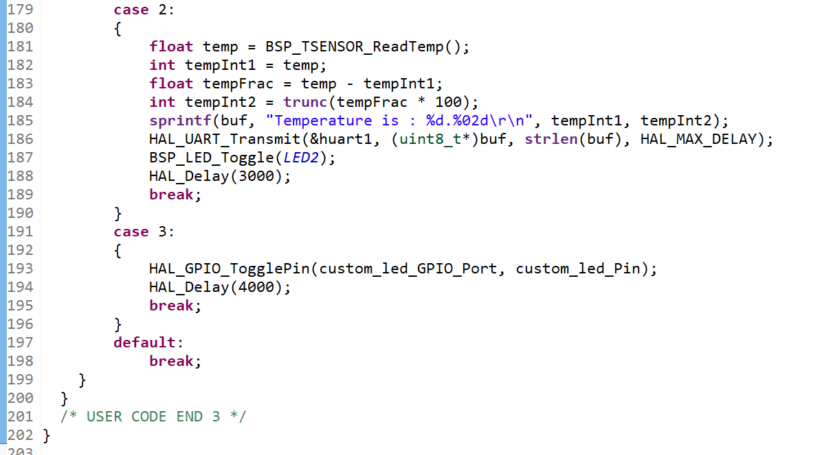
Step 13. Add the code for demo 1 to demo 4

Slide 15
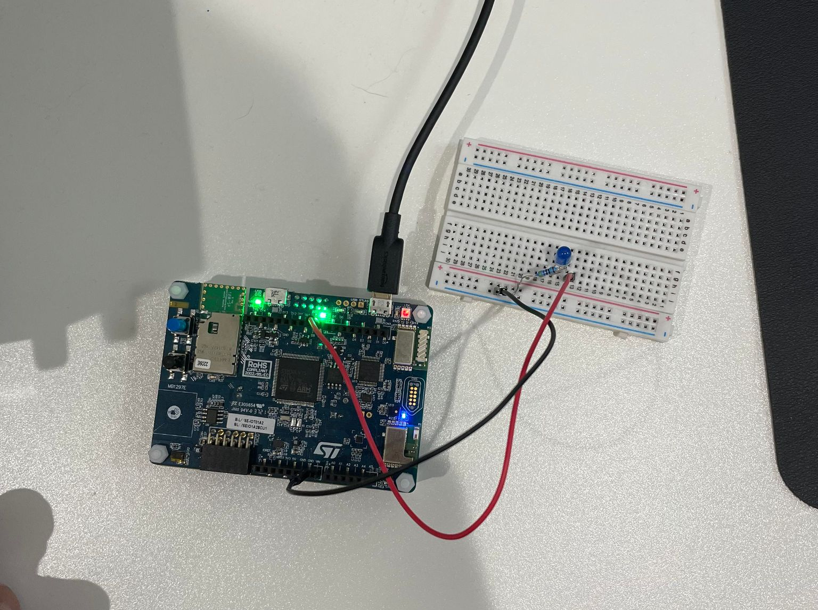
Step 14. Setup the wire connection for demo 4 LED blinking

Slide 16
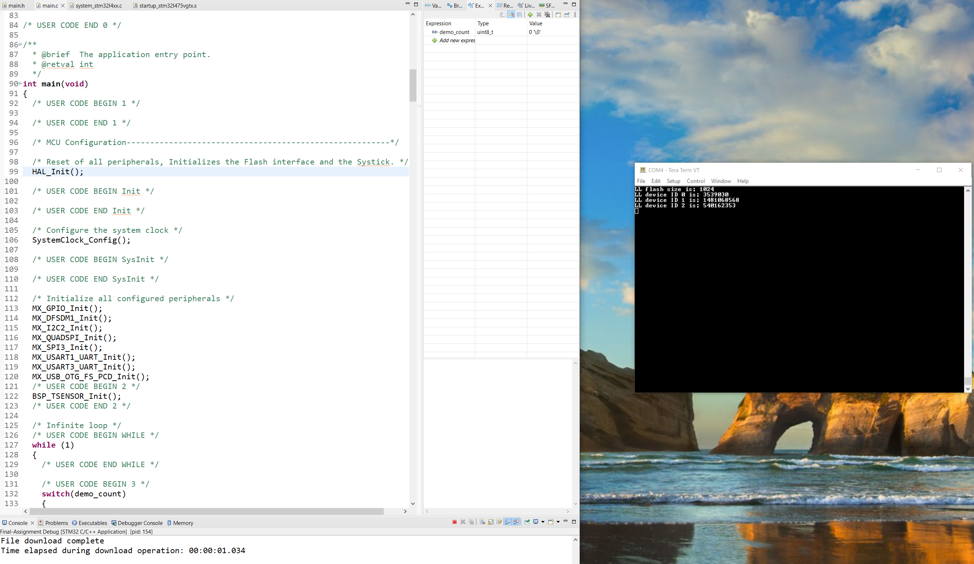
Step 15. Compile and run the code in debug mode, open tera term and test from demo 1. test is successful, print the flash size and device ID once when entering demo 1 code, and continue blinking LED2 at 1 second interval

Slide 17
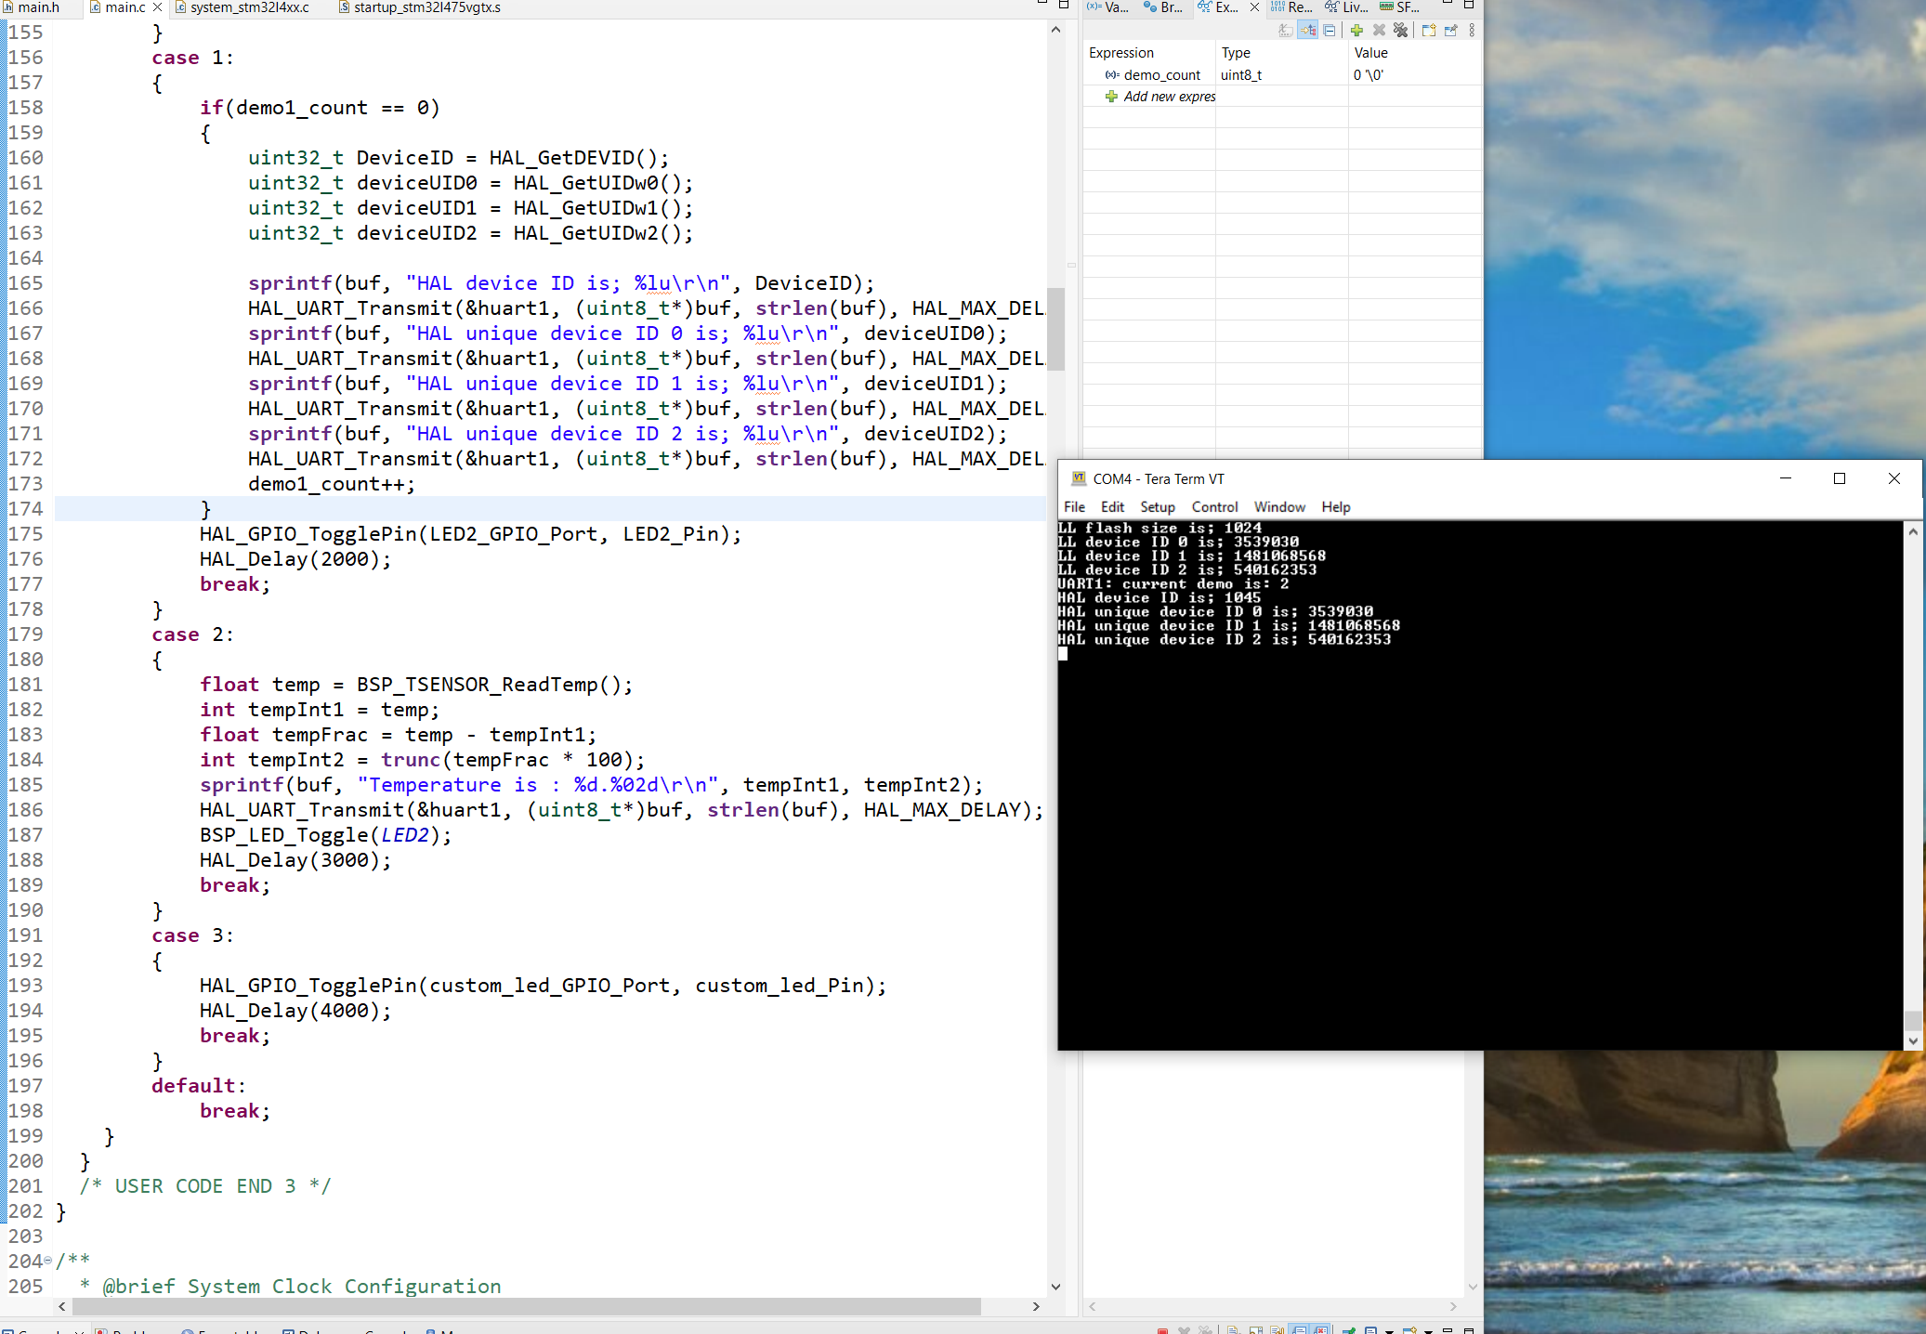
Step 16. Press the user button, we will see HAL device ID and unique ID only print once, and continue blinking LED for 2 seconds interval. Demo 2 success

Slide 18
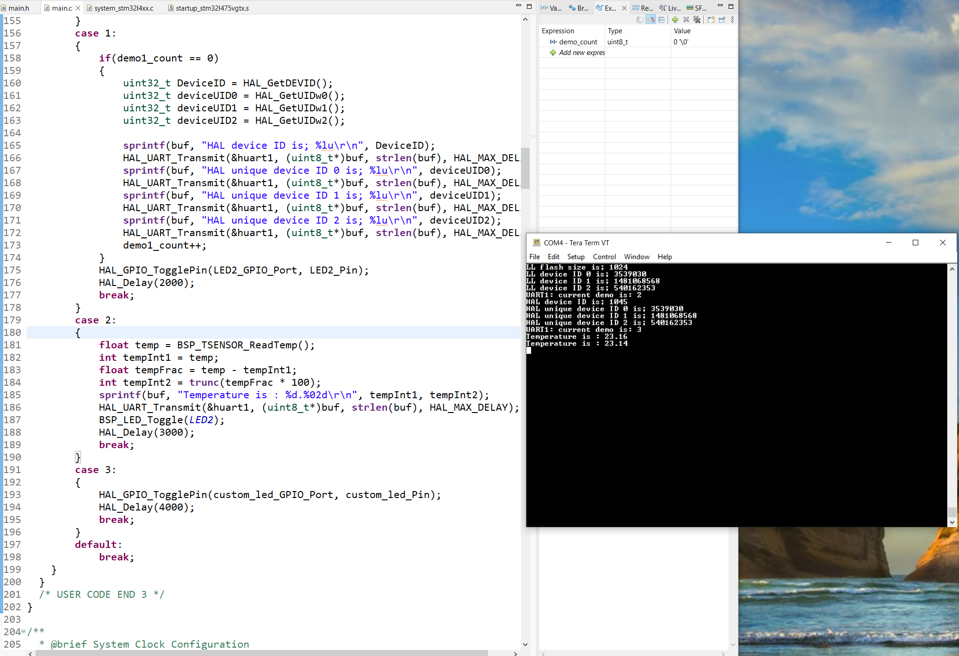
Step 17. Press the user button again, now we can read the temp value and send it through UART1. Demo 3 success

Slide 19
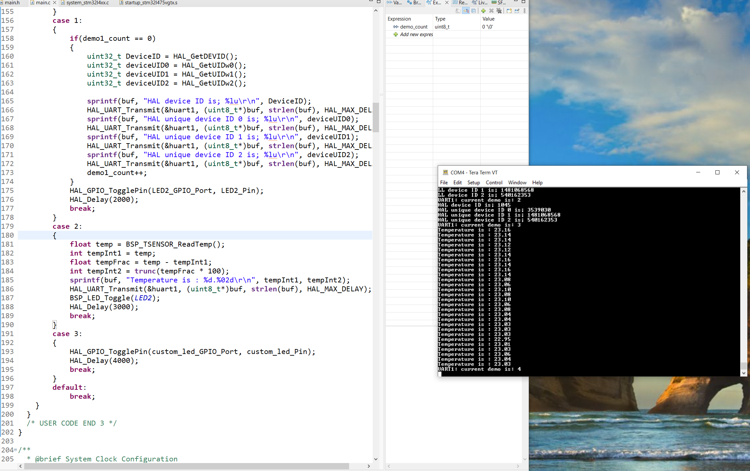
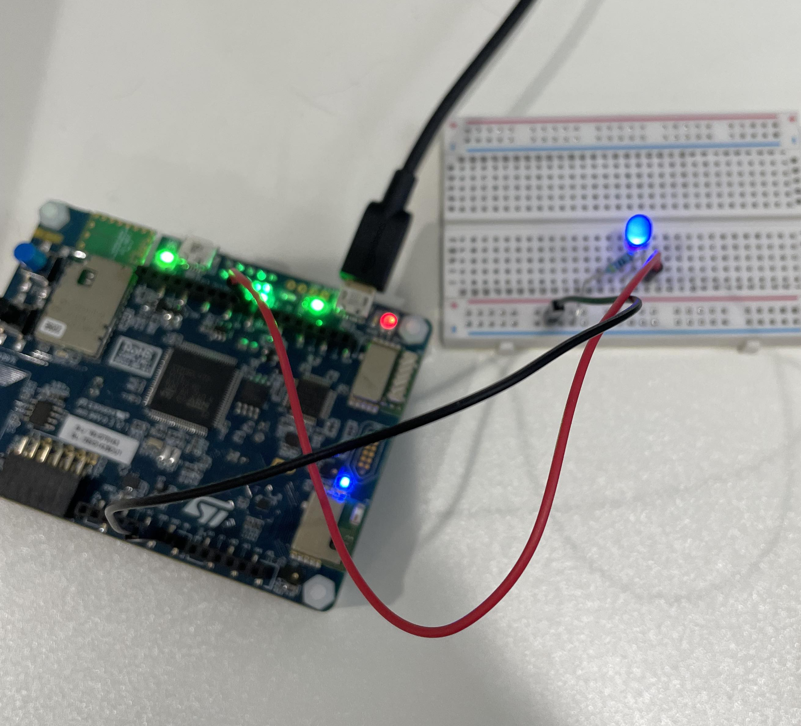
Step 18. Press the user button again, we can see the external LED blinking at 4 seconds interval. Demo 4 success

Slide 20
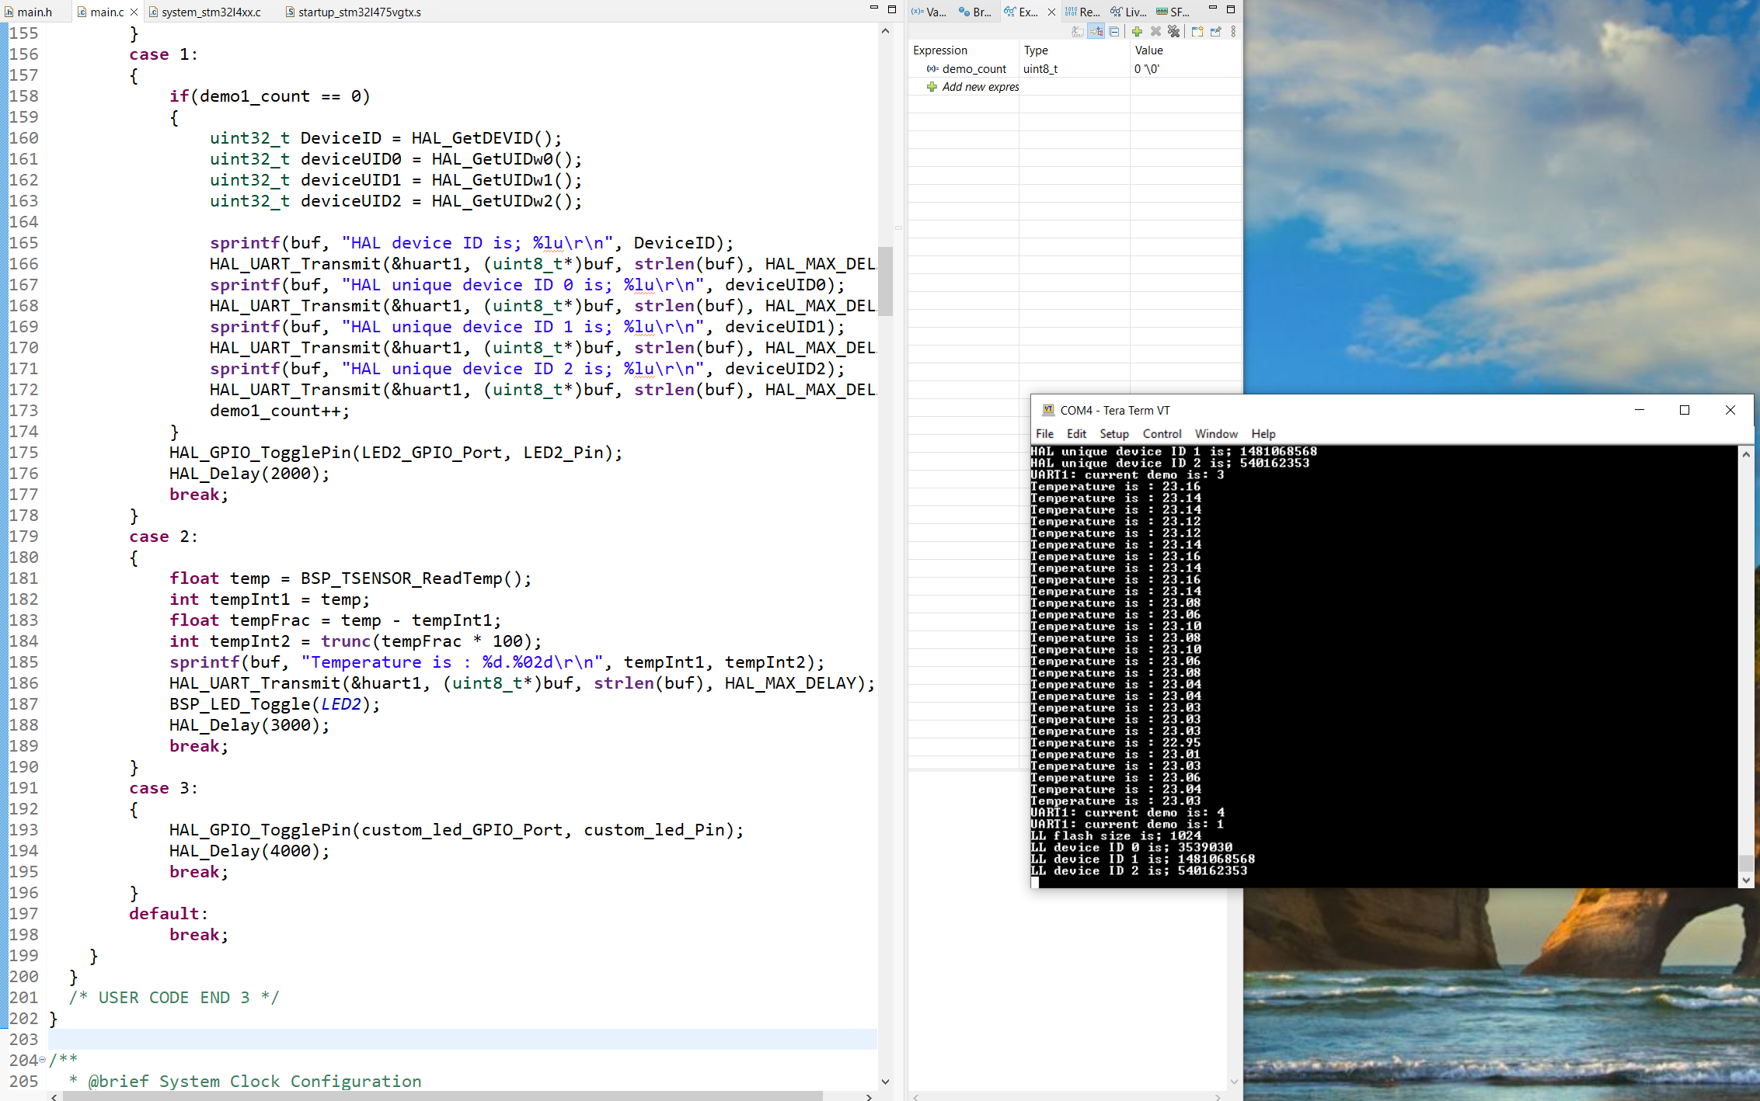
Step 19. Press the user button again, it will loop back to demo 1

